Slide 1
AI Resume Screening System (An AI-Powered Resume Analysis and ATS Screening Platform)
Presented By:
KARANAM SHARMILA
GOLI NITHIN
JAMPANA GANGADHAR SRIKANTH
KONDA HARSHINI

Slide 2
Agenda
Problem Statement
Solution Overview
Key Features
System Architecture
Future Work
Conclusion

Slide 3
Problem Statement
Manual resume screening is time-consuming.
Recruiters spend significant time reviewing resumes.
ATS systems may overlook suitable candidates.
Identifying missing skills manually is difficult.

Slide 4
Solution Overview
A web-based AI Resume Screening System.
Users upload resumes and enter the job description.
AI extracts resume information and matches skills with job requirements.
ATS score is generated automatically.
Missing skills and recommendations are provided.
Results are stored and displayed through an interactive dashboard.

Slide 5
Key Features
Resume upload in PDF format.
Automatic resume parsing.
AI-based skill matching with job description.
ATS score calculation.
Missing skills identification.
Personalized recommendations.
Dashboard with search and leaderboard.

Slide 6
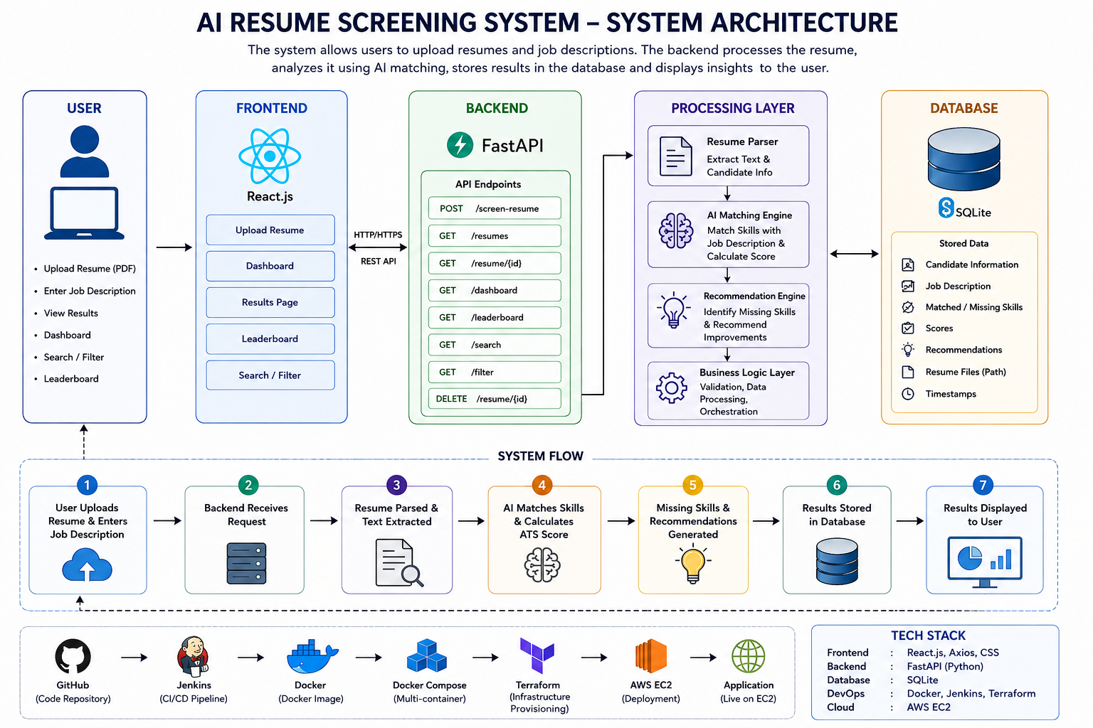
System Architecture

Slide 7
Future Work
Support multiple resume formats.
Improve AI matching accuracy.
Add interview question generation.
Integrate with job portals.
Provide real-time recruiter analytics.

Slide 8
Conclusion
An intelligent and automated resume screening solution.
Reduces manual screening effort.
Improves recruitment efficiency.
Provides ATS scores and skill recommendations.
Scalable using a cloud-based DevOps deployment.

Slide 9


